Slide 1
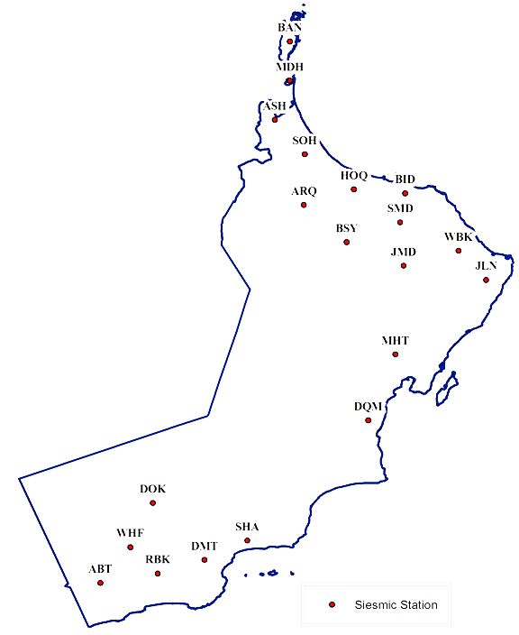
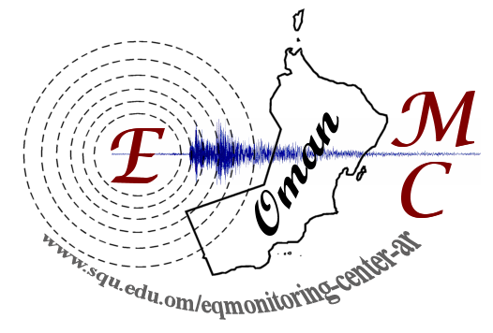
OMAN SEISMOLOGICAL NETWORK
Yousuf Al Shijbi
Zaid Al Habsi
Earthquake Monitoring Center,
Sultan Qaboos University
Training in Network Management Systems and Analytical Tools for Seismology
23-27 October 2017 Baku, Azerbaijan

Slide 2
History of EMC
The work to establish an earthquake monitoring center started in the mid 1990
Decision of the Council of Ministers 10/95 on May 2, 1995, formed a committee
First phase (ten seismographic stations) in 2001
Second phase, three broadband Stations added in 2004
Third phase (seven seismographic stations) are completed in 2011.

Slide 3
Objectives
Monitors, analyses and reports on earthquakes within Oman and internationally 24/7.
Assess the seismic hazard in the Sultanate through locating all SSZ.
Offering advice and consultations, conducting earthquake-related seminars and spreading knowledge to the public about earthquakes, and reducing their hazards.
Advise government bodies on their programs of research, development and implementation.
Notes:
Since inception in 2001

Slide 4
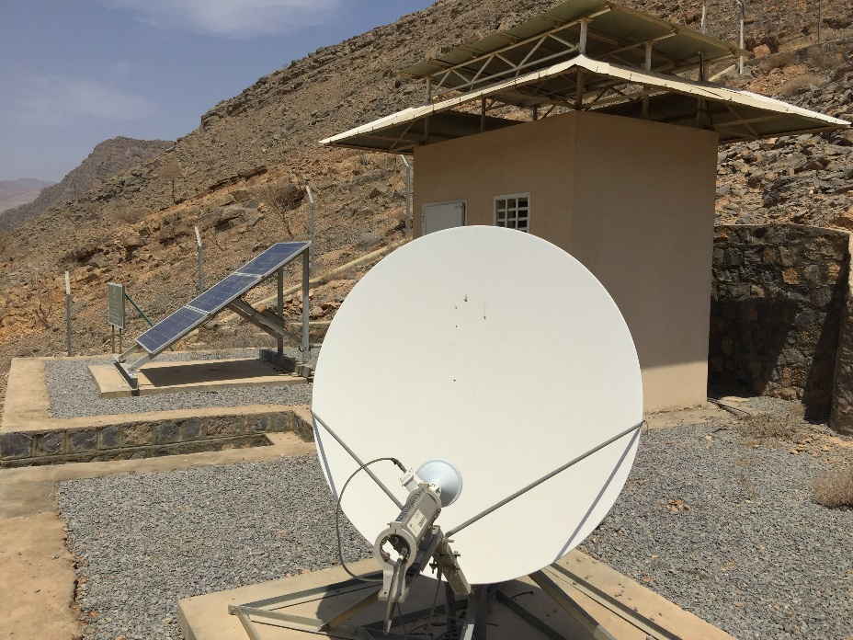
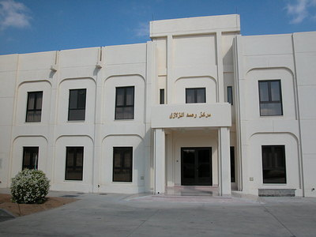
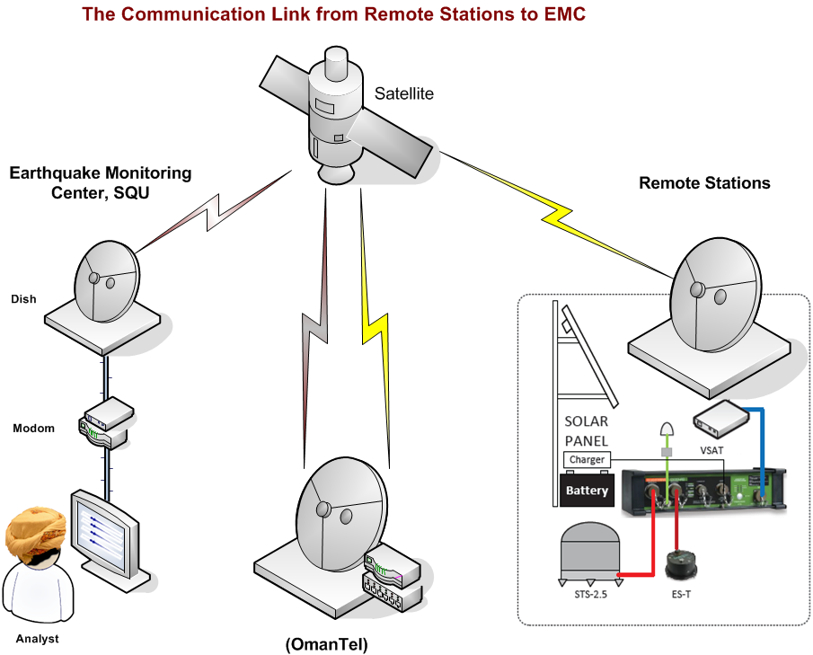
EMPO
(1) Central Data Acquisition System (CDAS)
(20 + 1) Remote seismic stations (RSS).
The communication link through Omantel’s satellite hub

Slide 5
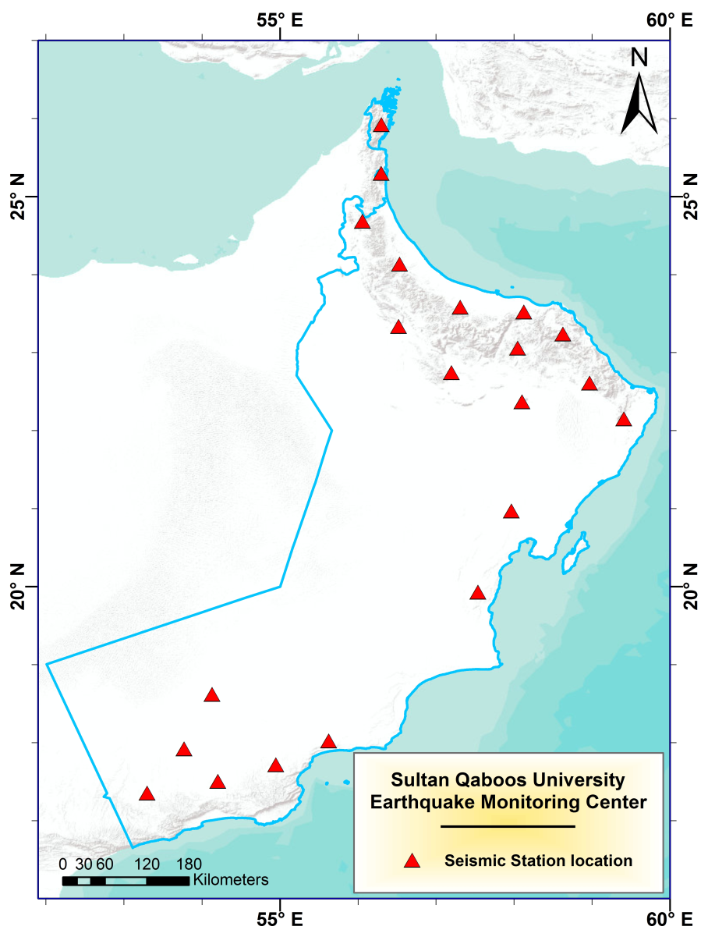
RSS
Notes:
Factors considered in the selection of site for
seismic stations:
Earthquake sources around Oman
Population and infrastructures
Station accessibility, hardrock foundation,
low seismic noise level
Station distribution
Communication links

Slide 6
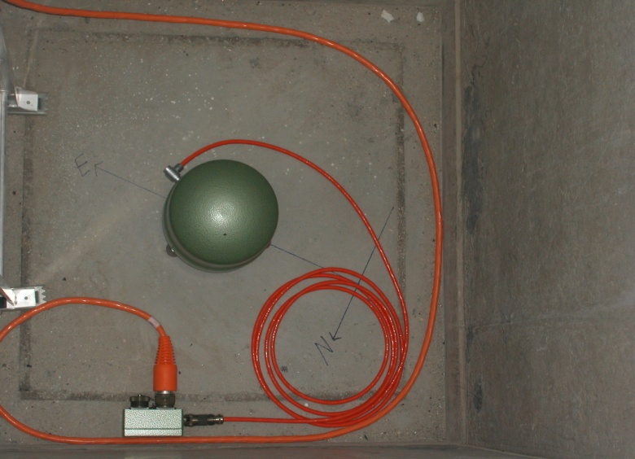
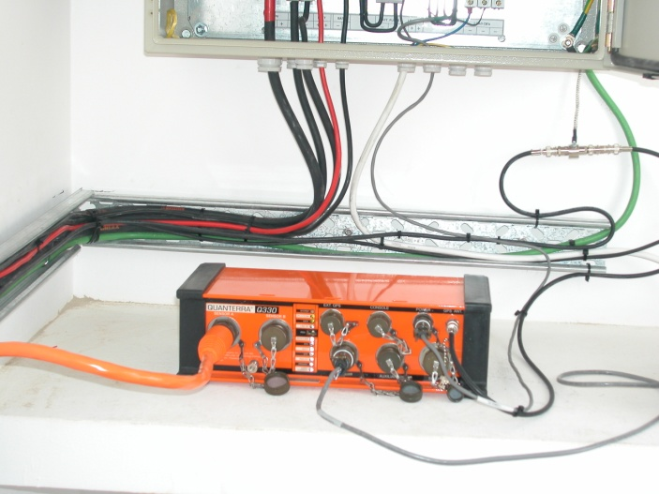
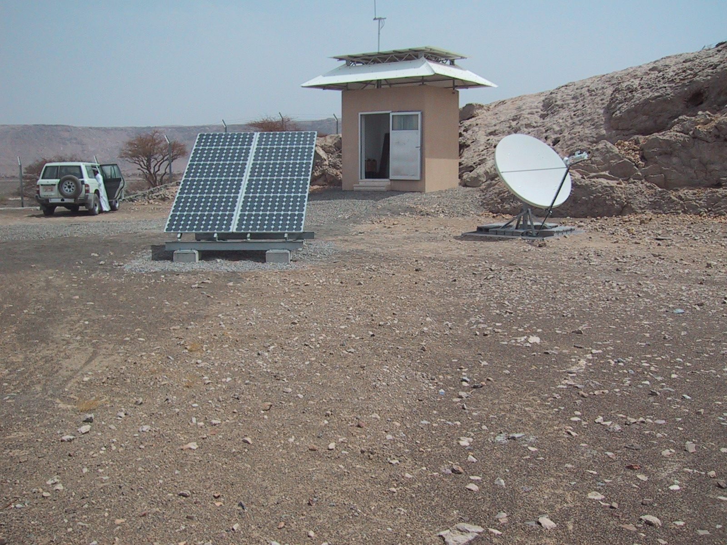

Slide 7
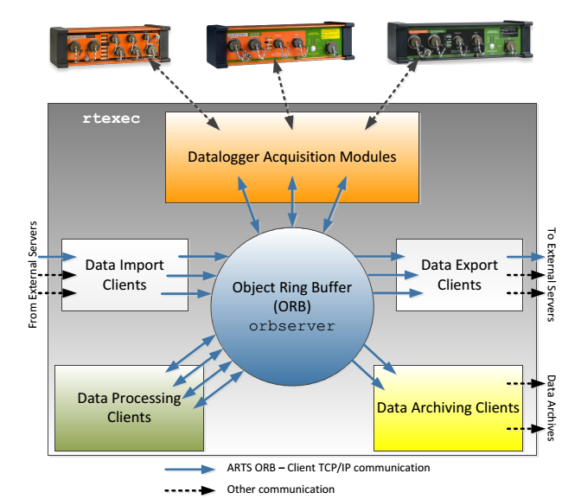
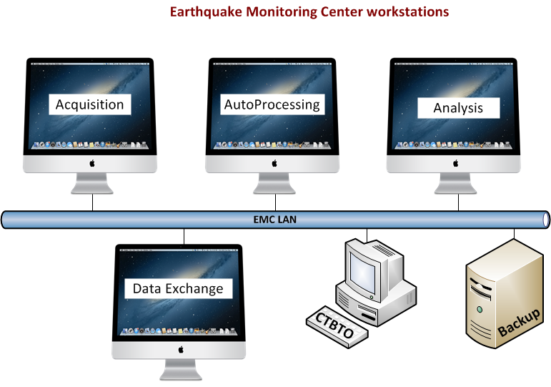
Design of Antelope Real Time System
Notes:
Antelope is a collection of software which implements the acquasition, distribution, archiving, and prosessing of environmental monitoring data.
Runs on Mac OS/X
Antelope function can be broken into two major catagories: automated real time processing and off-line batch mode processing

Slide 8
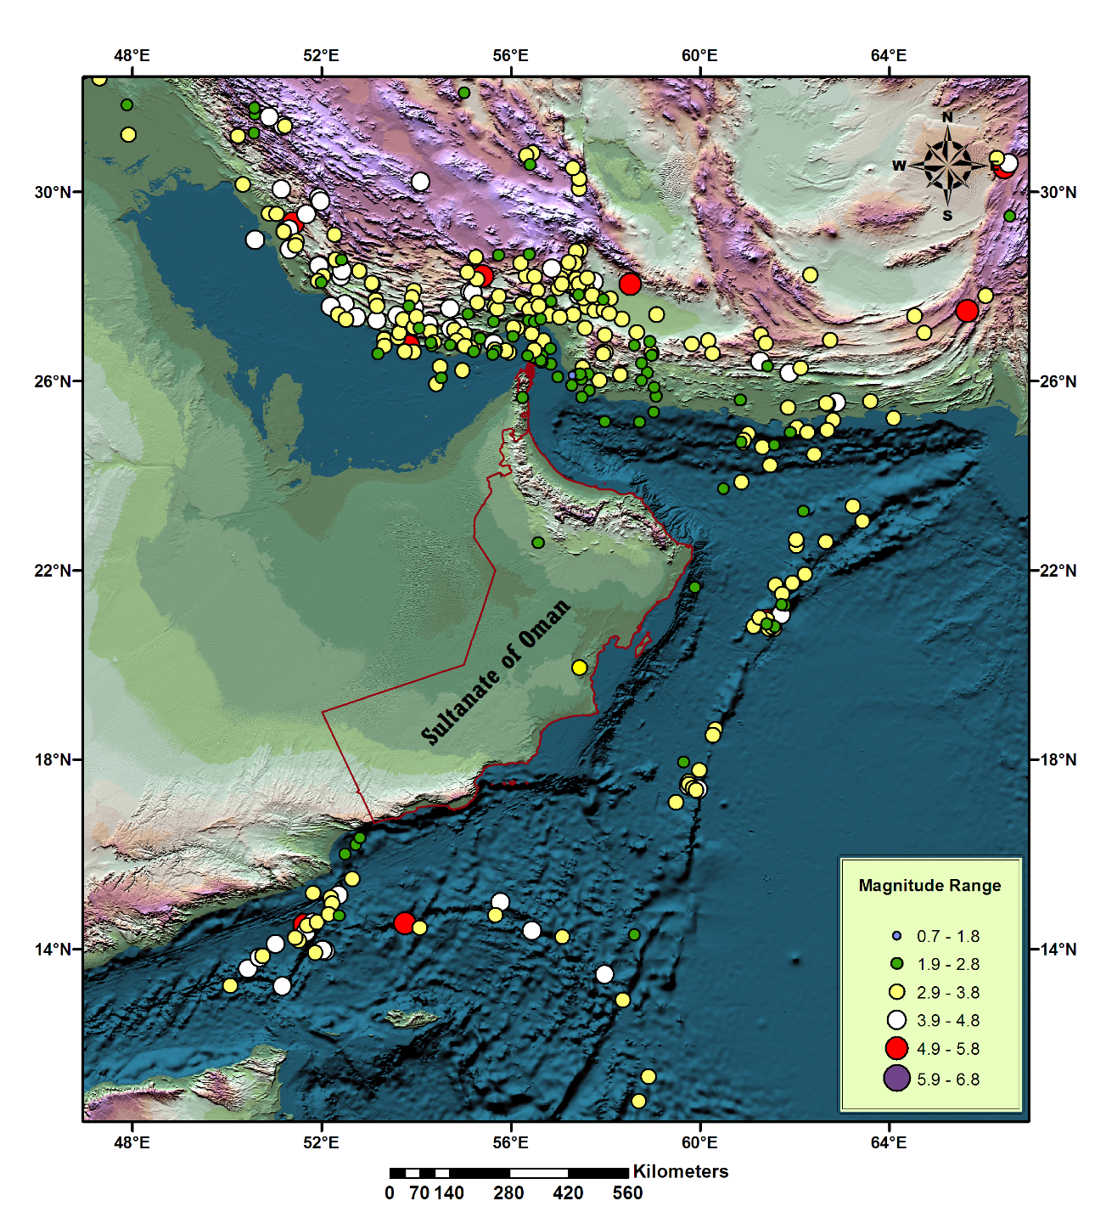
Seismicity map

Slide 9
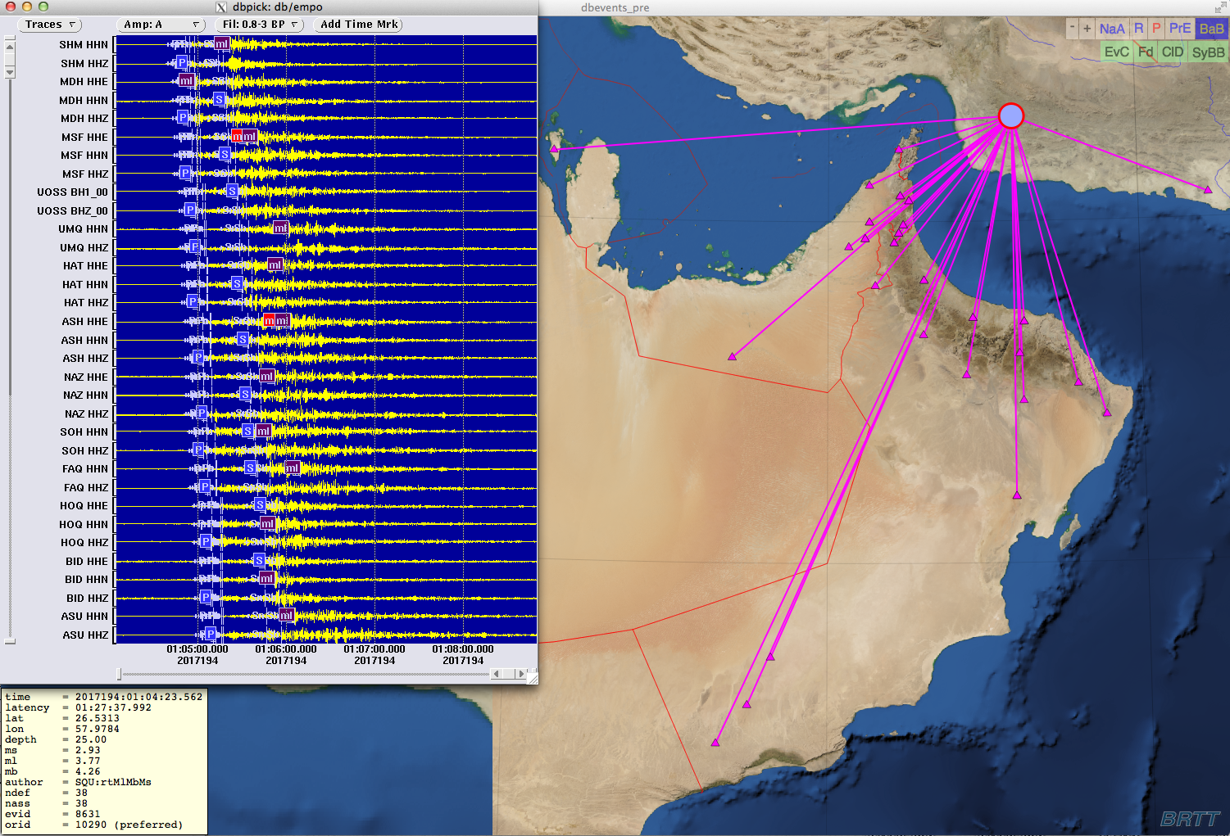

Slide 10
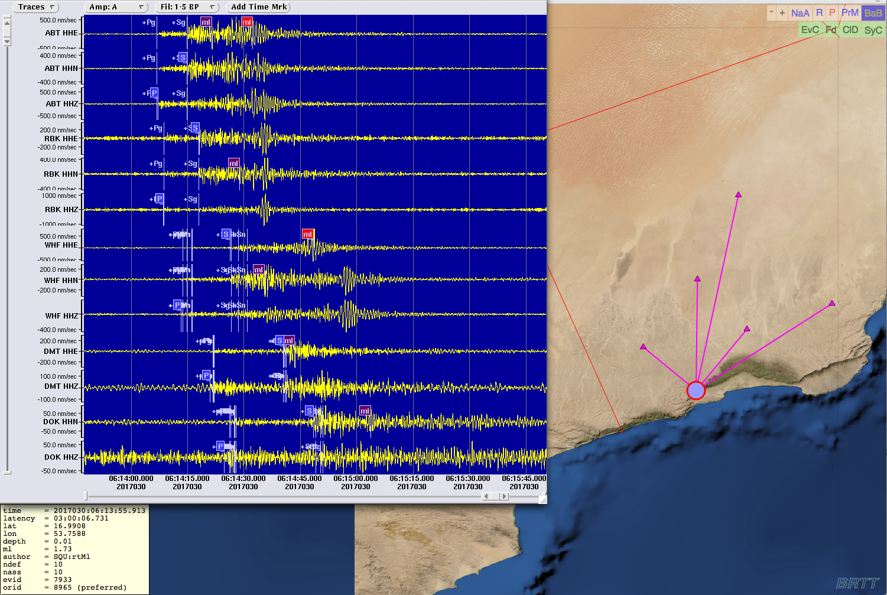

Slide 11
External Collaborations
LOU with Lawrence Livermore National Laboratory, 2004
LOU with Dubai Municipality, 2006
LOU with KISR –Kuwait, 2008
LOU with MIT, 2009
MOU with NCMS of UAE, 2010
LAU Kandilli Observatory, Turkey, 2012
LAU Lisbon, IPL, 2013
LAU Keil University, Germany, 2014
MOU with PACA, Oman, 2017

Slide 12
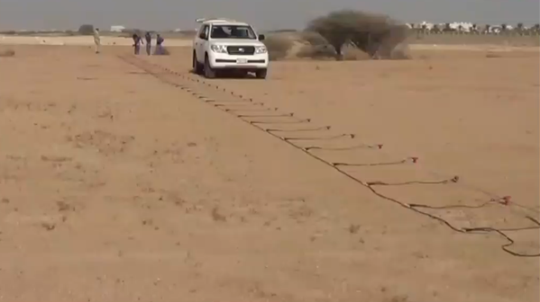
Research Activities
Seismic Microzoning for MOD Military Bases in Muscat Governorate 2017
Seismic Hazard assessment for Oman Muesum-Across ages, RCA, 2016
Soil Investigation at Areas B & C, Duqm Region, 2014
Tsunami hazard assessment for the Oman Liquefied Natural Gas (OLNG) site, 2013-2014
Soil Investigation at Area A, Duqm Region, 2013
Subsurface Caves and Void Detection at Road-2, Duqm Region, 2013
Deterministic seismic hazard assessment for site 6 at Yibal Oil Field 2012
Seismic Hazard Assessment (SHA) project 2009-2013
Yibal Microseismic project with PDO 2008-2009
Construction (CTBTO) seismic station,2005
Yibal microseismic project 2004-2005

Slide 13
Future expansion
(6) New broadband seismic stations
(62) Strong ground motion stations

Slide 14
Conclusions
The EMC has been in operation since July 2001 Data Collection / Data Management
Data collected to date indicate the presence of a relatively moderate earthquake in the north and low in middle and south of the Sultanate.
The EMC is involved in Public awareness and education about earthquakes and mitigation of the hazards
The EMC collaborates with major regional and international agencies dealing with earthquakes and their hazards

Slide 15
10th Gulf Seismic Forum(GSF) 19-22 March 2018 Muscat
https://conferences.squ.edu.om/Portals/7/emcconf/index.html

Slide 16
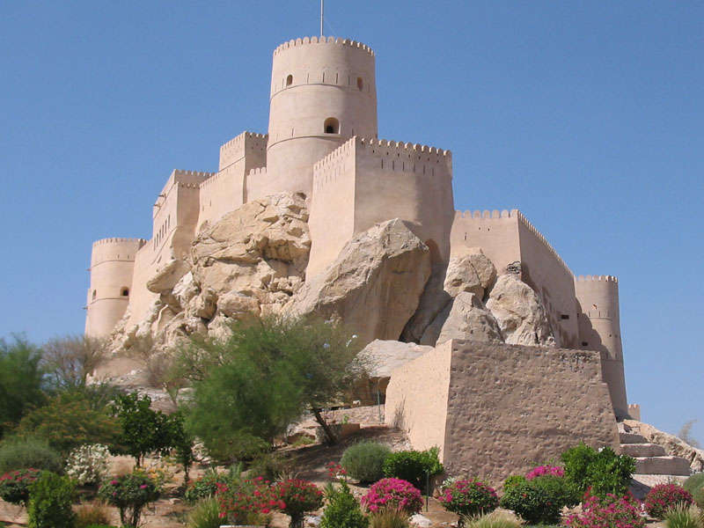
Thank You

